Slide 1
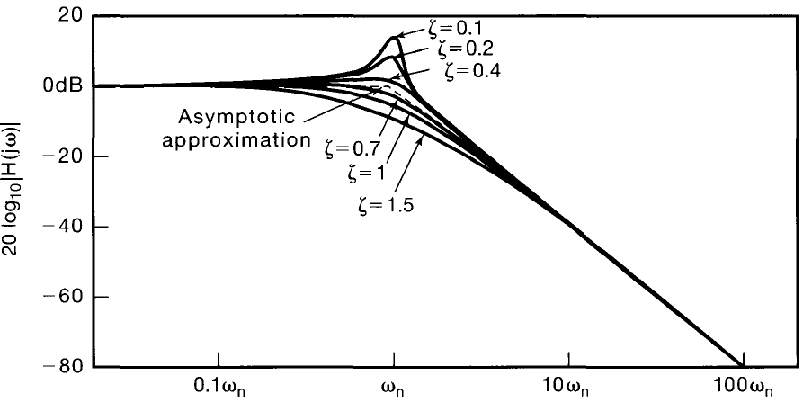



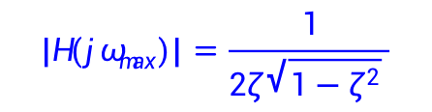

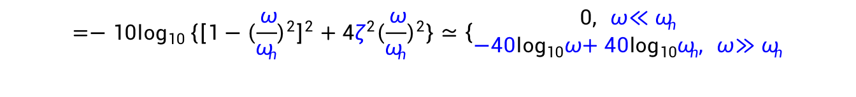
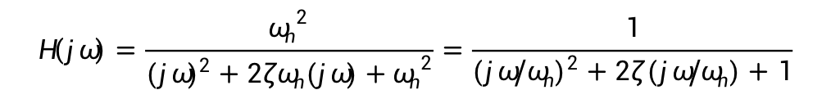
6.5 First- and second-order systems
Second-order CT system: bode plot
$$H\left(jω\right)=\frac{{ω_{n}}^{2}}{{(jω)}^{2}+2ζω_{n}(jω)+{ω_{n}}^{2}}=\frac{1}{{(jω/ω_{n})}^{2}+2ζ(jω/ω_{n})+1}$$
$$20\log_{10}\left|H\left(jω\right)\right|=−20\log_{10}|{(jω/ω_{n})}^{2}+2ζ(jω/ω_{n})+1|$$
$$=−10\log_{10}\left\{{\left[1−{\left(\frac{ω}{ω_{n}}\right)}^{2}\right]}^{2}+4ζ^{2}{\left(\frac{ω}{ω_{n}}\right)}^{2}\right\}≃\left\{\begin{matrix}0, {ω≪ω}_{n} \\ {−40\log_{10}ω+40\log_{10}ω_{n}, ω≫ω}_{n}\end{matrix}\right.$$
$ω_{max}=ω_{n}\sqrt{1−2ζ^{2}}$
$ζ$<0.707
$$\left|H\left(jω_{max}\right)\right|=\frac{1}{2ζ\sqrt{1−ζ^{2}} }$$
40-dB-per-decade
Quality $Q=$
$$\frac{1}{2ζ }$$

Slide 2
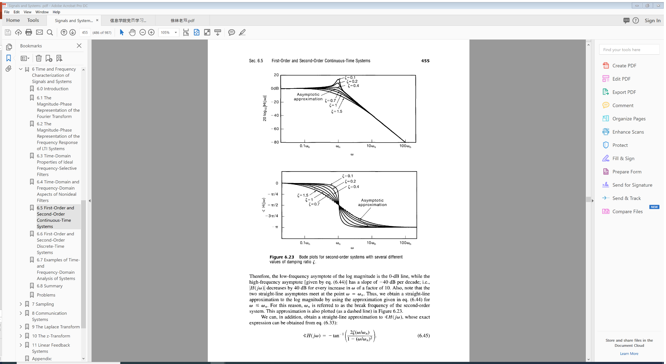


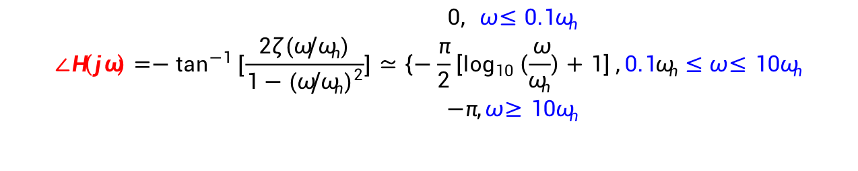
6.5 First- and second-order systems
Second-order CT system: bode plot
$$H\left(jω\right)=\frac{{ω_{n}}^{2}}{{(jω)}^{2}+2ζω_{n}(jω)+{ω_{n}}^{2}}=\frac{1}{{(jω/ω_{n})}^{2}+2ζ(jω/ω_{n})+1}$$
$$∠H\left(jω\right)=−\tan^{−1}\left[\frac{2ζ(ω/ω_{n})}{1−{(ω/ω_{n})}^{2}}\right]≃\left\{\begin{matrix}0, {ω≤0.1ω}_{n} \\ −\frac{π}{2}\left[\log_{10}\left(\frac{ω}{ω_{n}}\right)+1\right] \\ −π,{ω≥10ω}_{n}\end{matrix}\right.,{0.1ω_{n}≤ω≤10ω}_{n}$$
$$∠H\left(jω_{n}\right)=−\frac{π}{2}$$
$$Why 0\sim −π?$$

Slide 3
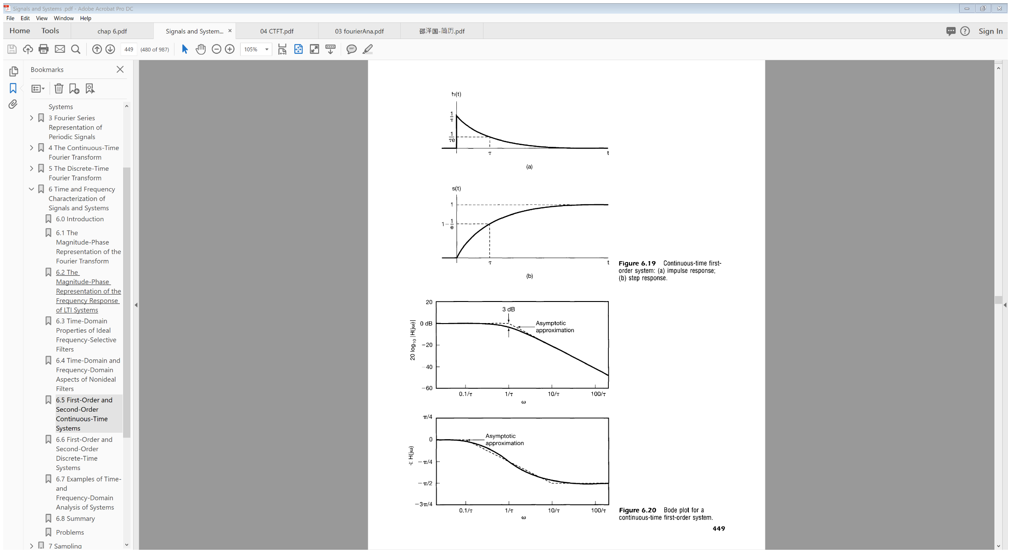
6.5 First- and second-order systems
First and second-order system: comparison
Second-order
First-order

Slide 4
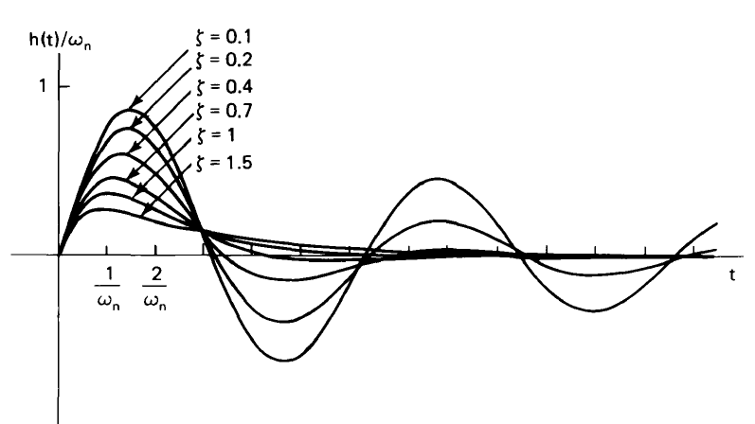






6.5 First- and second-order systems
First and second-order system: comparison
Second-order
First-order
Second-order
First-order
$$h\left(t\right)=\frac{1}{τ}e^{−t/τ}u(t)$$
$$h\left(t\right)=\frac{ω_{n}e^{−ζω_{n}t}}{\sqrt{{1−ζ}^{2}}}[sin({ω_{n}t\sqrt{{1−ζ}^{2}}})]u(t)$$
$ω_{n}$: time frequency scaling
$τ$: time frequency scaling
$$H\left(jω\right)=\frac{1}{{(jω/ω_{n})}^{2}+2ζ(jω/ω_{n})+1}$$
$$H\left(jω\right)=\frac{1}{jωτ+1}$$

Slide 5
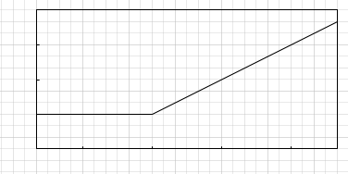
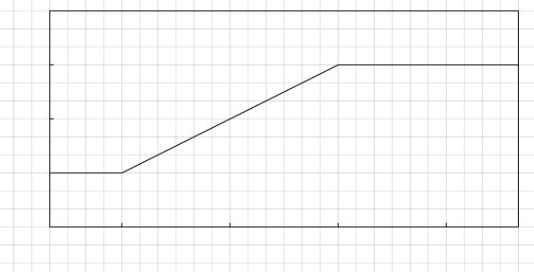
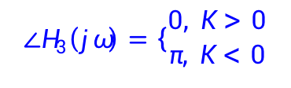


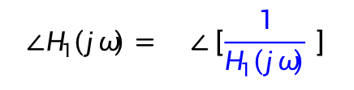
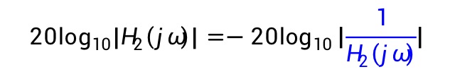



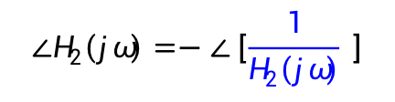
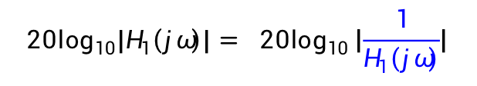











6.5 First- and second-order systems
Bode plots for rational frequency responses
$H_{1}\left(jω\right)=jωτ+1$
60
$$20\log_{10}\left|H_{1}\left(jω\right)\right|= 20\log_{10}\left|\frac{1}{H_{1}\left(jω\right)}\right|$$
40
$$20\log_{10}\left|H_{1}\left(jω\right)\right|$$
$−$
$$∠H_{1}\left(jω\right)= ∠\left[\frac{1}{H_{1}\left(jω\right)} \right]$$
20
$$−$$
0 dB
-20
$0.1$/$τ$
$$1/τ$$
10/$τ$
100/$τ$
$$ω$$
$$H_{2}\left(jω\right)={(jω/ω_{n})}^{2}+2ζ(jω/ω_{n})+1$$
$$20\log_{10}\left|H_{2}\left(jω\right)\right|=−20\log_{10}\left|\frac{1}{H_{2}\left(jω\right)}\right|$$
$$∠H_{2}\left(jω\right)=−∠\left[\frac{1}{H_{2}\left(jω\right)} \right]$$
$$H_{3}\left(jω\right)=K$$
3$π$/4
$π$/2
$$∠H_{1}\left(jω\right)$$
If $K>0$, $K=\left|K\right|e^{j0}$, if $K<0$, $K=\left|K\right|e^{jπ}$
$π$/4
$$20\log_{10}\left|H_{3}\left(jω\right)\right|=20\log_{10}\left|K\right|$$
0
$$∠H_{3}\left(jω\right)=\left\{\begin{aligned}0, K>0 \\ π, K<0\end{aligned}\right.$$
$−π$/4
$0.1$/$τ$
$$1/τ$$
10/$τ$
100/$τ$
$$ω$$

Slide 6
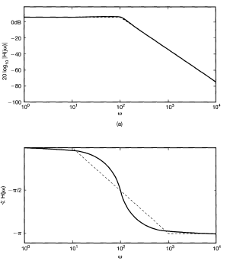



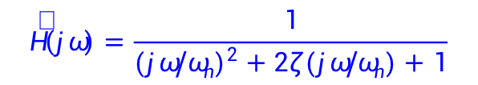
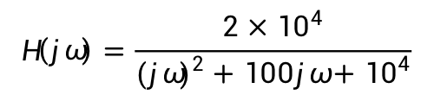
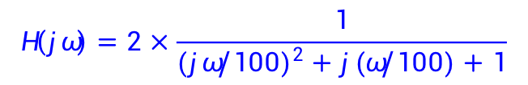

6.5 First- and second-order systems
Bode plots for rational frequency responses: example 1
$$H\left(jω\right)=\frac{2×{10}^{4}}{{(jω)}^{2}+100jω+{10}^{4}}$$
$$\hat{H}\left(jω\right)=\frac{1}{{(jω/ω_{n})}^{2}+2ζ(jω/ω_{n})+1}$$
$$H\left(jω\right)=2×\frac{1}{{(jω/100)}^{2}+j(ω/100)+1}$$
$${ ω}_{n}=100, ζ=0.5$$
$$20\log_{10}\left|H\left(jω\right)\right|=20\log_{10}2$$
$$+20\log_{10}\left|\hat{H}\left(jω\right)\right|$$
$$∠H\left(jω\right)=∠\hat{H}\left(jω\right)$$

Slide 7
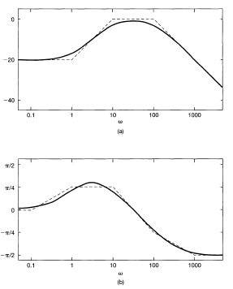




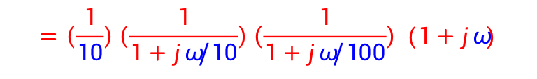
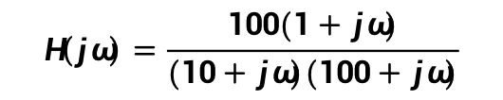
6.5 First- and second-order systems
Bode plots for rational frequency responses: example 2
$$H\left(jω\right)=\frac{100(1+jω)}{(10+jω)(100+jω)}$$
$$=\left(\frac{1}{10}\right)\left(\frac{1}{1+jω/10}\right)\left(\frac{1}{1+jω/100}\right) (1+jω)$$
$ω_{r}=1/τ$:
$$10$$
$$100$$
$$1$$

